Slide 1
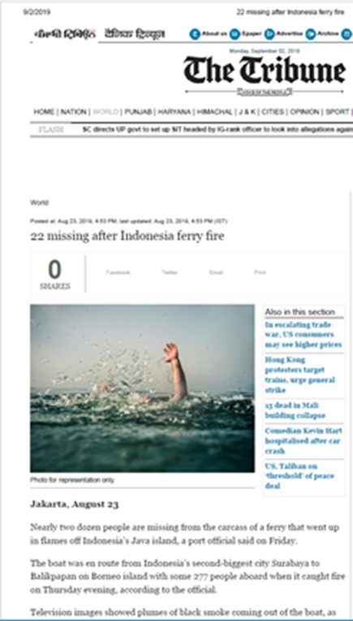
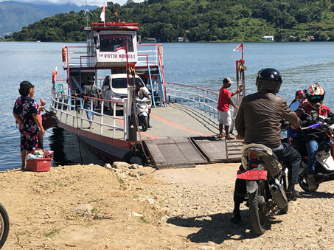
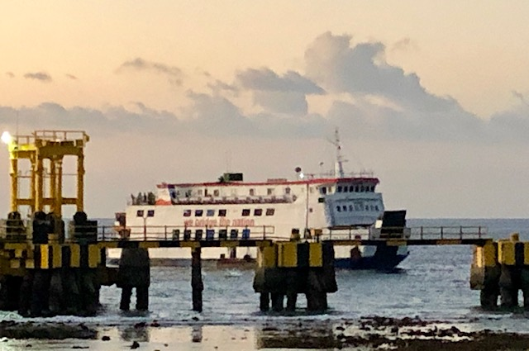
Ferry Safety in Indonesia October 2019
Elena Chesheva Transport Cluster Leader for Indonesia and Timor-Leste

Slide 2
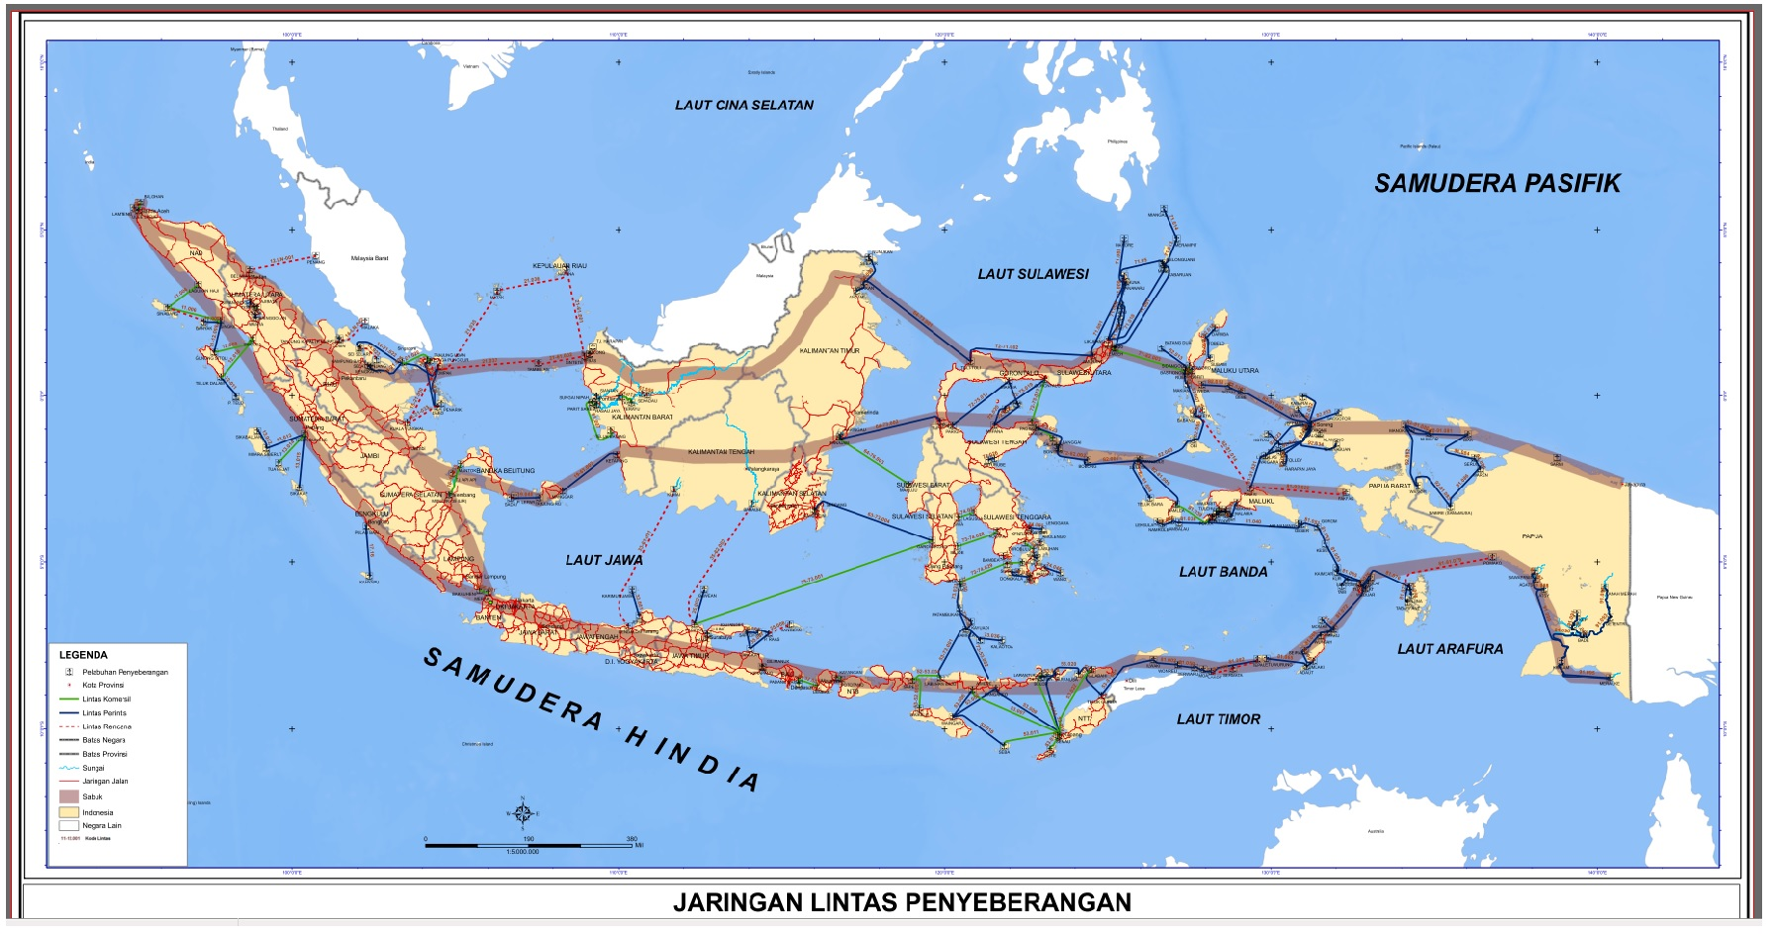
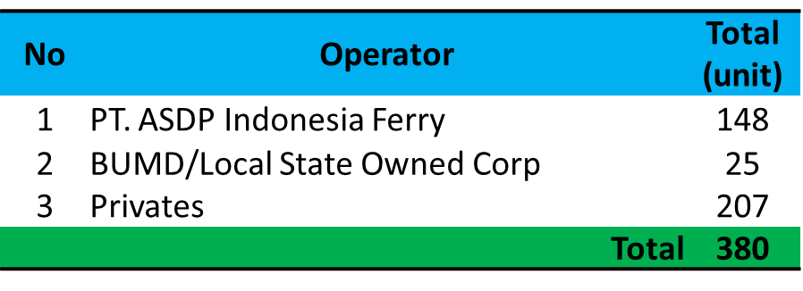
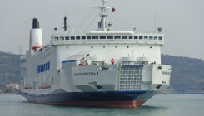
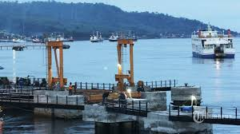
2017 INDONESIA FERRY TRANSPORT DEVELOPMENT
No Ferry lane 278 :
55 Commercial
223 Pioneer
91 unit Pioneer
446 Ferry Ports
380 Unit vessels
289 unit Commercial
Kapal penyeberagan perintis
Kapal penyeberangan komersil
Information from National Transportation Safety Commission

Slide 3
Indonesia: number of accidents and fatalities 2000 - 2019
Since the year 2000 there were 2945 fatalities

Slide 4
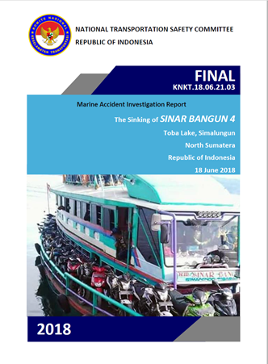
Fatal Accident on Lake Toba – June 2018
167 people died, 19 were rescued
Ferry was 4 times overloaded (designed for 48 passengers) plus 70 motorcycles (not allowed for by the design)
Illegal vessel modification
Stability issue
Obstructed egress
Unavailable safety equipment
Bad weather
No proper communications system
Inadequate search and rescue
In Lake Toba more than 300 ferries operate, but only 4 are certified
35 landings, inefficient use of constructed terminals

Slide 5
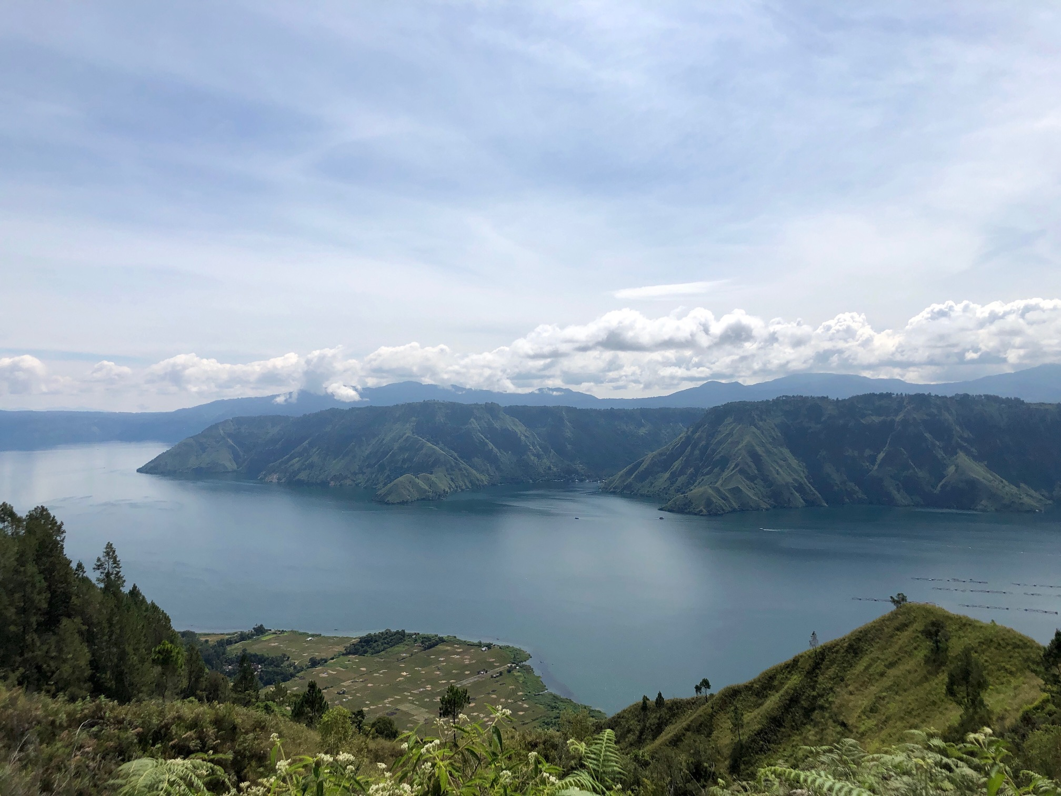
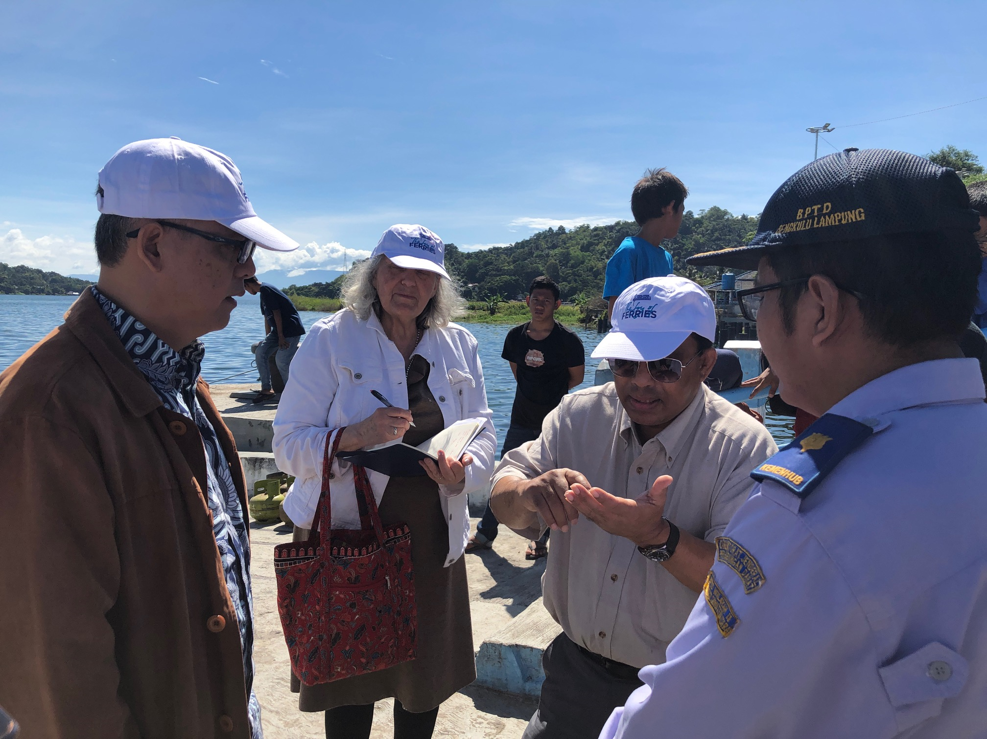
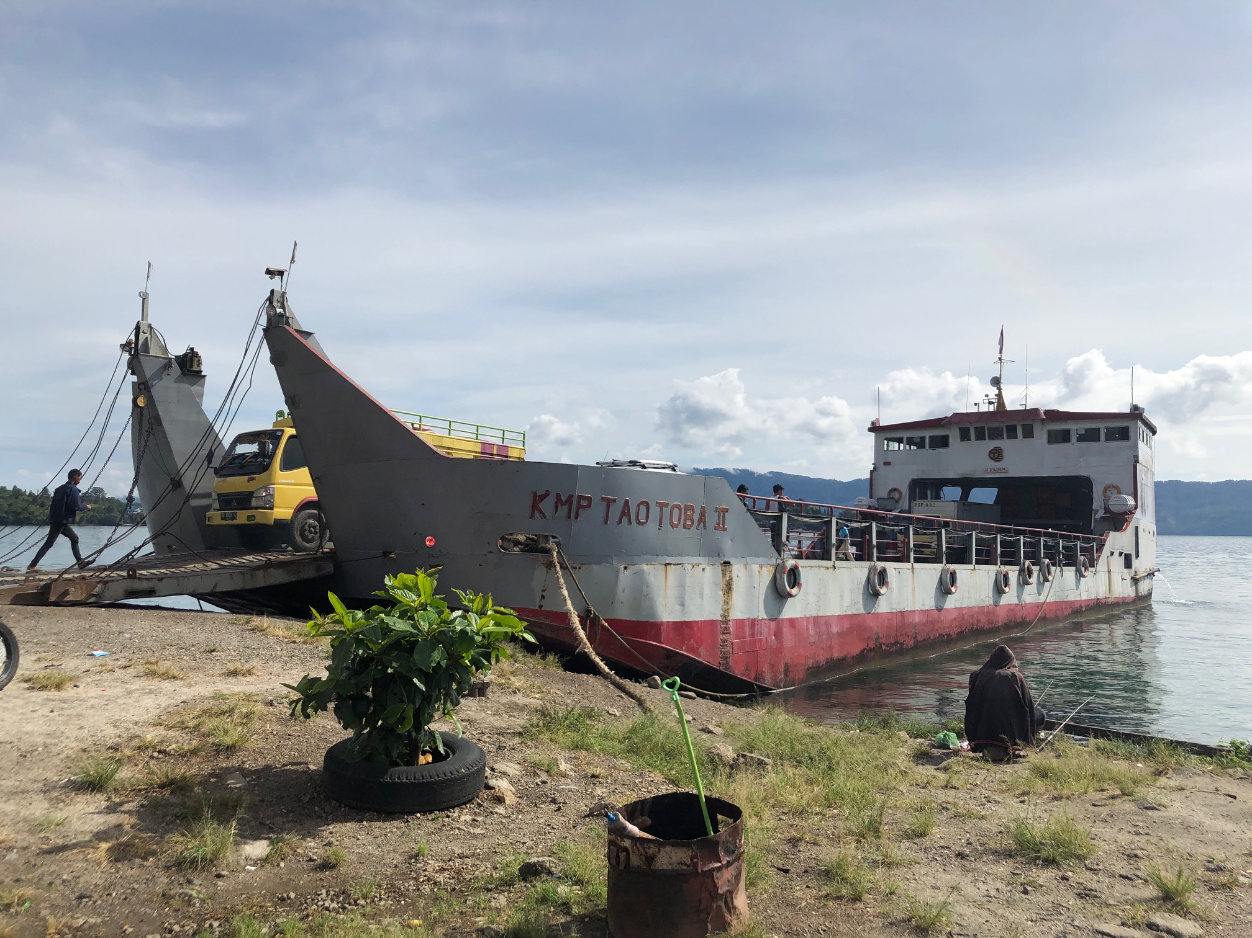
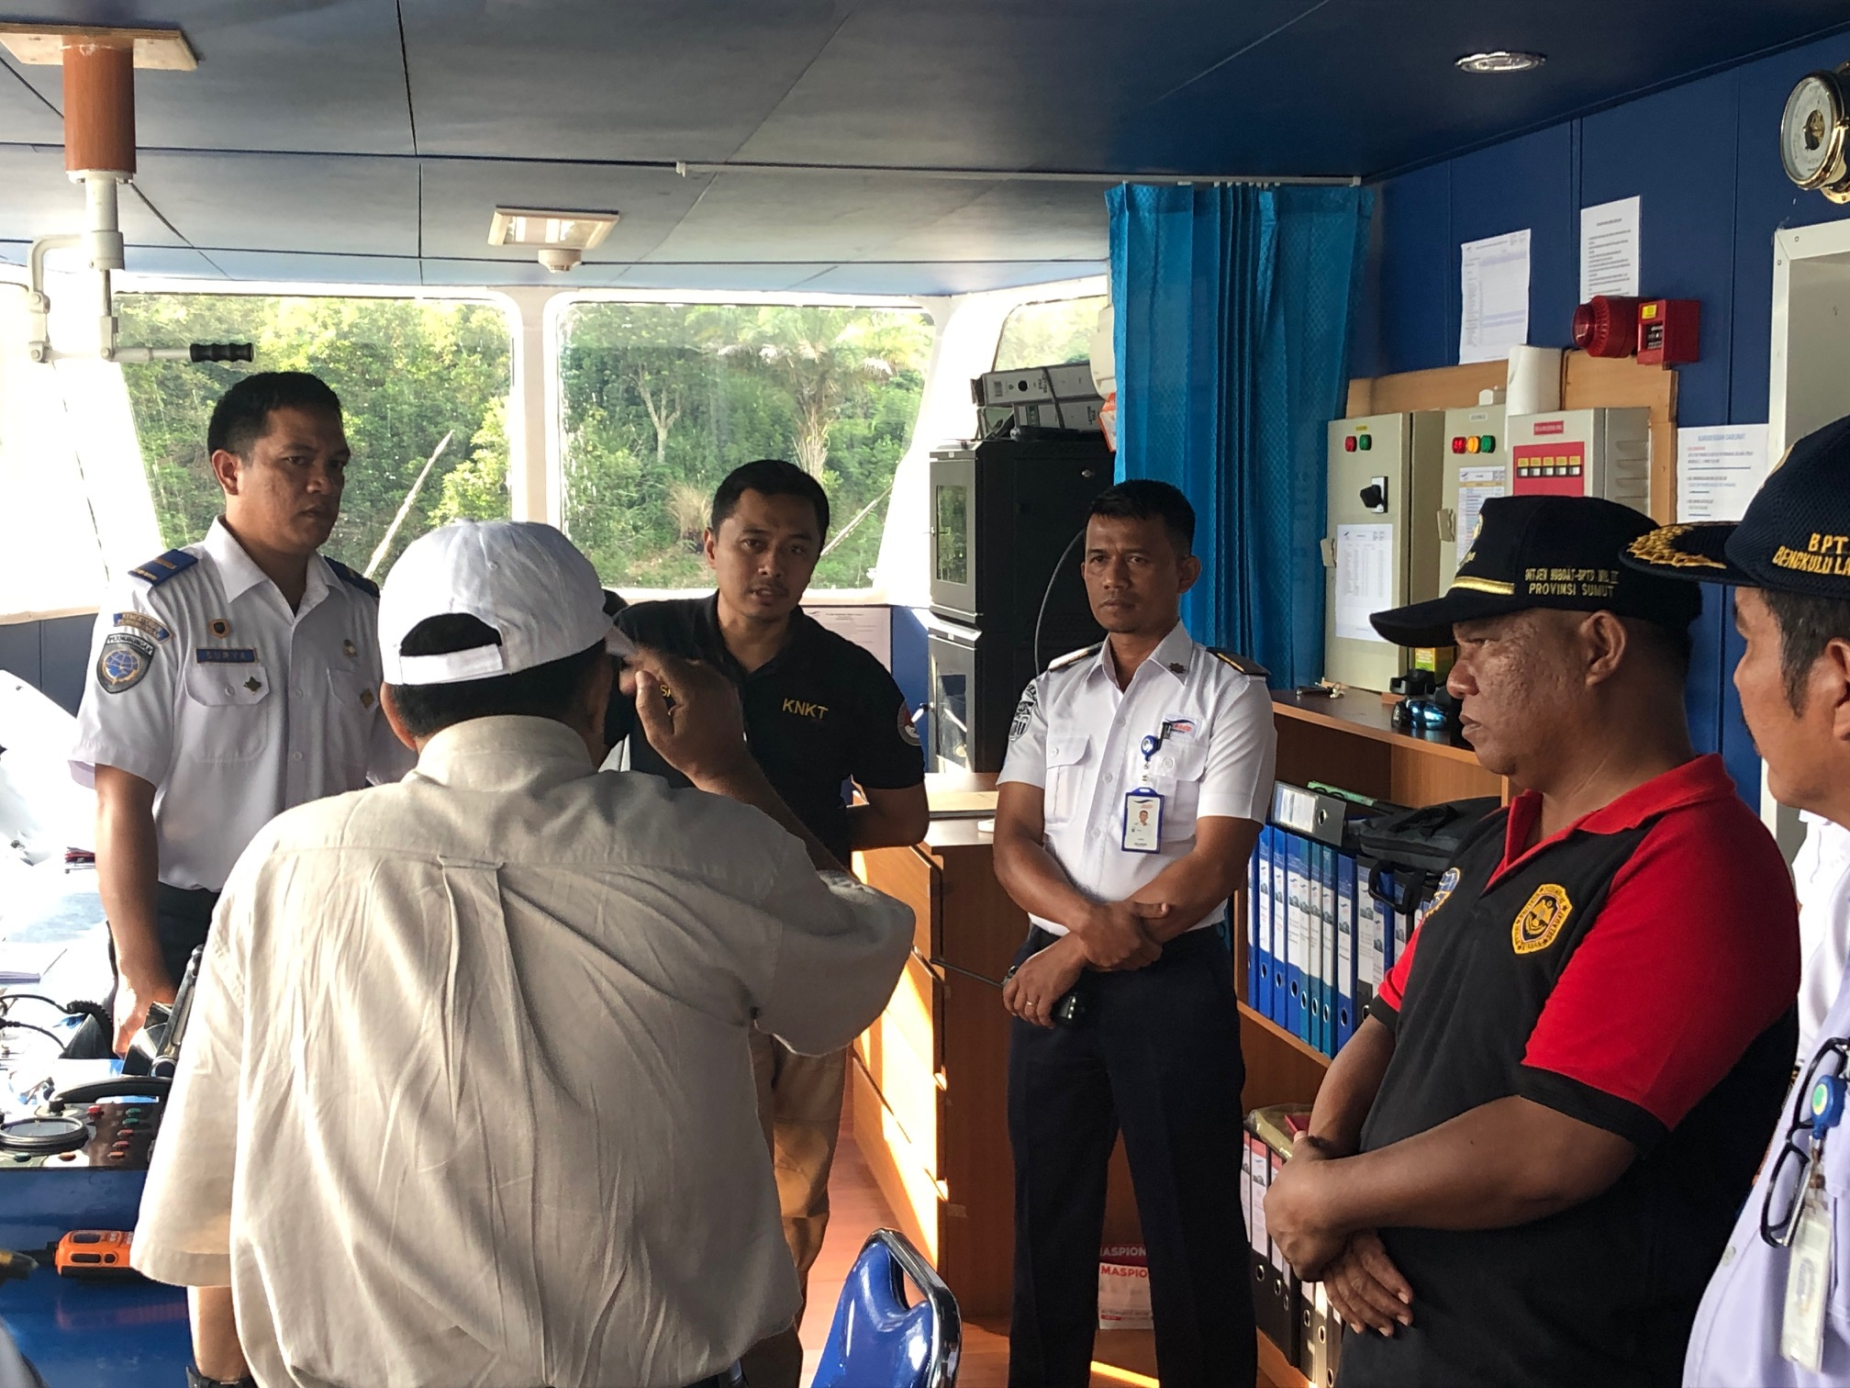
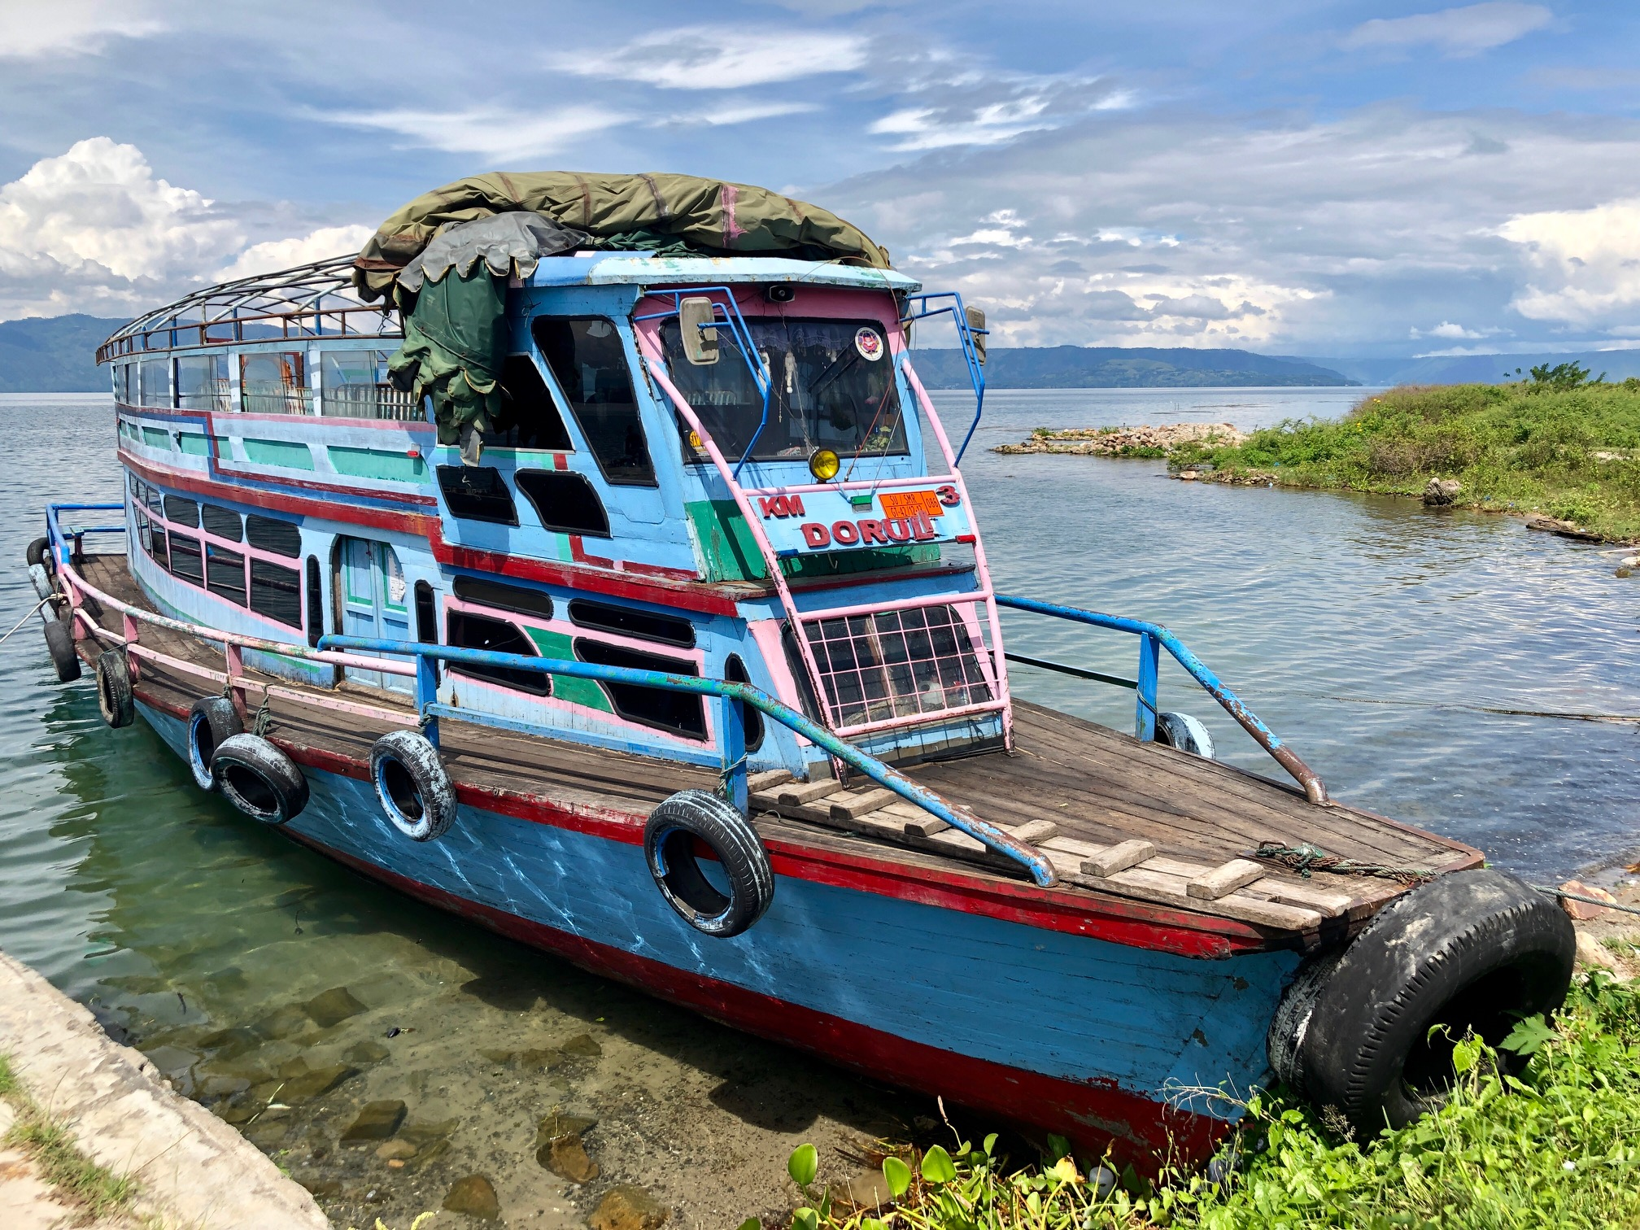
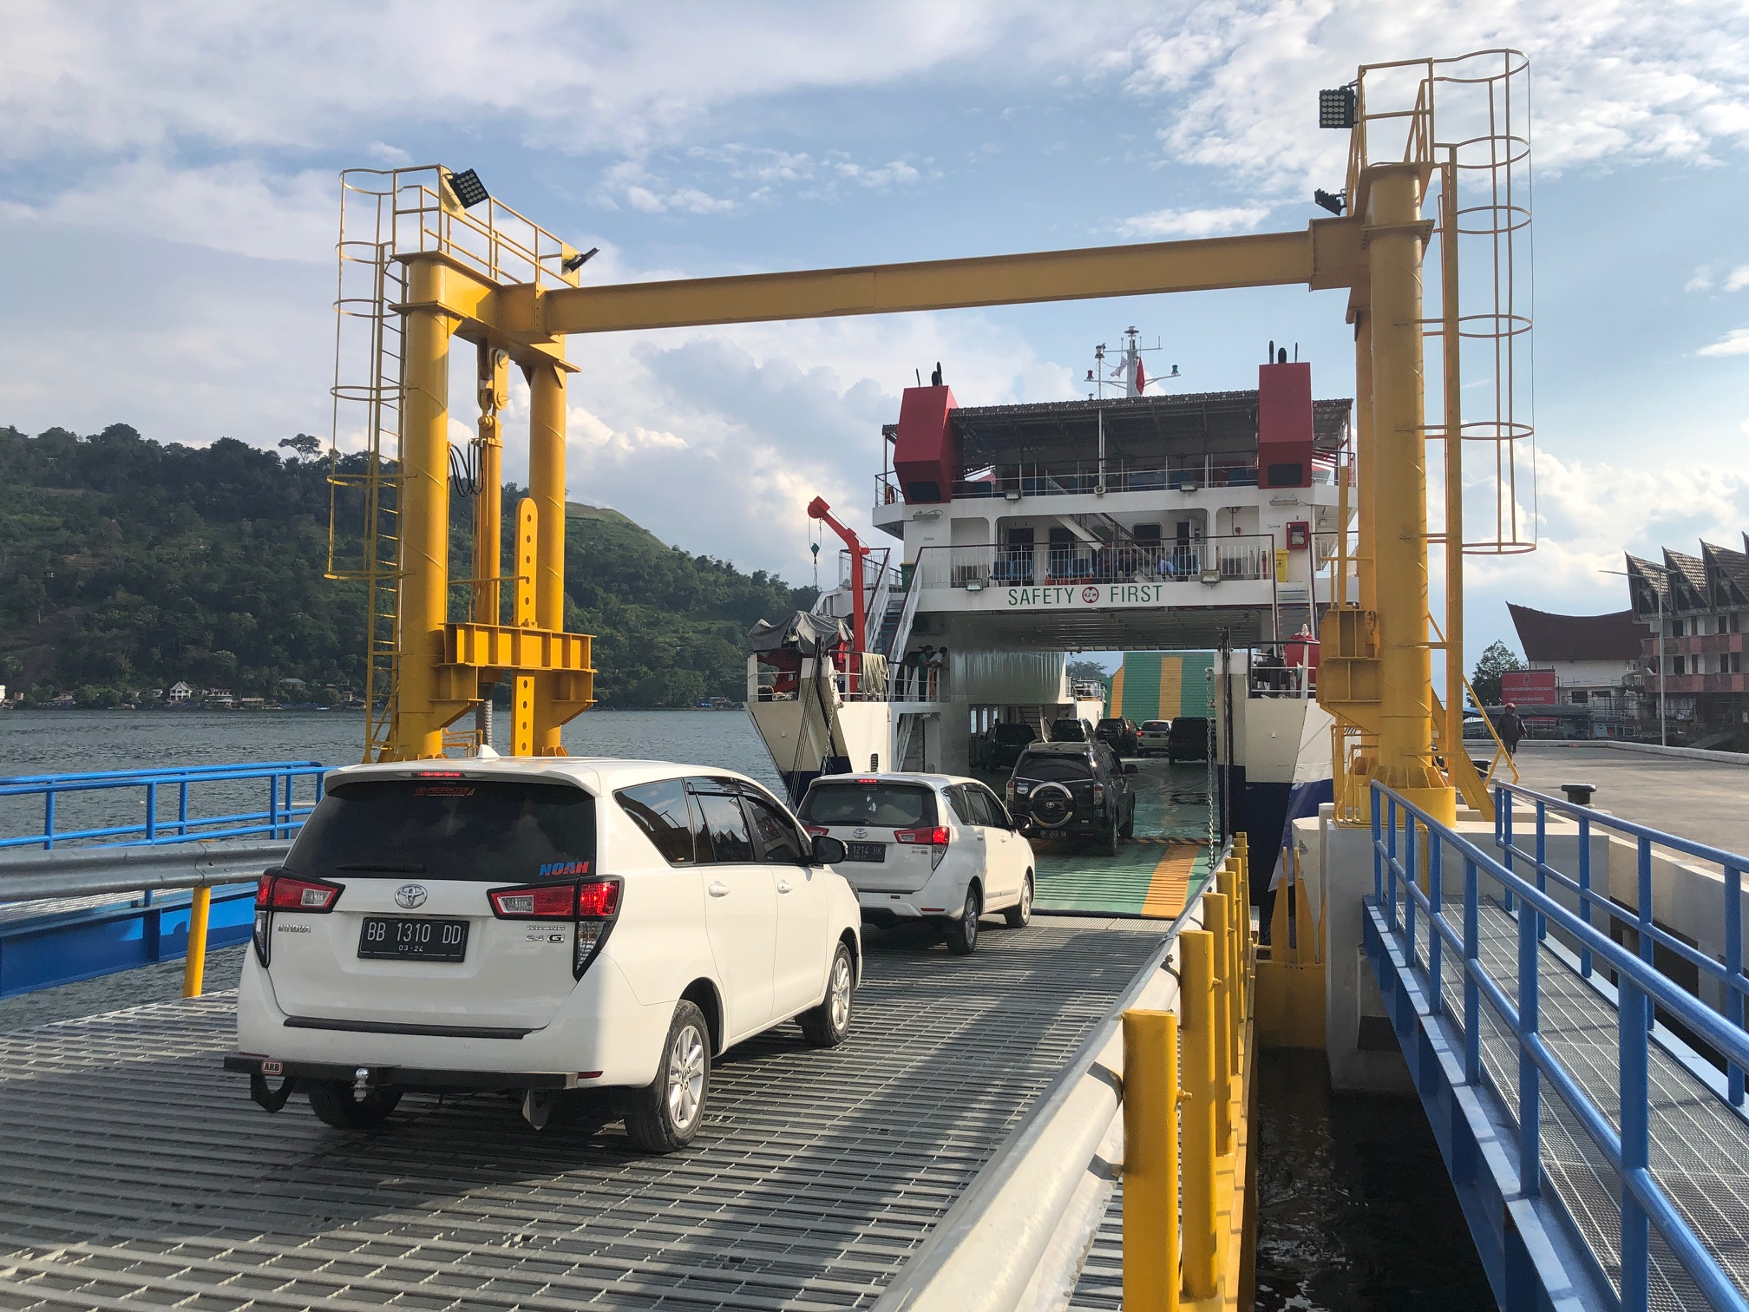
Lake Toba Visit together with WFSA

Slide 6
Ferry Safety Challenges – nation-wide
No system of advance booking, no electronic ticketing in majority of operations
Ineffective passenger and cargo manifest system, no enforcement of loading limits, control of passengers
Operational Issues: vehicle’s cargo handling and securing, vehicle stowage, inaccurate or absence of stability calculation, no weight information
Unreported and uninspected cargo inside vehicles: hazardous cargo – (fire hazards for RoRos)

Slide 7
Ferry Safety Challenges – nation-wide
Ship design not appropriate for designated area of operation, substandard, vessel alterations
Weak seamanship practice
Ferry traffic monitoring, communications systems inefficient
Risk assessment during heavy weather, weather monitoring
Shortcoming of Safety and Emergency Equipment
Crew preparedness and training

Slide 8
Recommendations

Slide 9
Recommendations - Operations
Create master plan for Lake Toba ferry operations – terminals, vessels, routes.
Cargo monitoring and passenger embarkation process: improving cargo and passenger reporting system
Control the number of passengers and cargo to regulated levels - manifests
Establish communication systems for ferries - VHF radio for lake Toba ferries
Weather detection and communication - expand Automatic Weather Monitoring Display system piloted in Tiga Ras and establish weather monitors at the major terminals
Plan services during peak tourist activity (esp during Ramadan)

Slide 10
Recommendations
Crew Competence
Mandate competence for skippers (captains) and crew
Improve crew readiness and performance to handle the emergency situation – drills, training
basic International Convention for Safety of Life at Sea (SOLAS) training for all crew plus advanced training for certain functions
Safety equipment and its proper storage – availability
Effective and availability SAR Response

Slide 11
Recommendations
Improve Vessel safety:
Register and certify vessels
Phase out substandard vessels
Start developing new safer and cleaner vessels
Regulatory aspect and governance:
National level work on regulatory framework, standards, SOPs and guidelines
Clear division of responsibilities

Slide 12
World Bank Support

Slide 13
World Bank Engagement
Policy dialogue and expert advice
Tourism project – investments in Lake Toba facilities,
Lake Toba Transport Safety improvement proposal as part of Integrated Tourism Masterplan
Potential Ports Projects in Maluku and Nusa Tenggara Timur (NTT) provinces – optimization of RoRo services including focus on safety

Slide 14
Thank you

